Slide 1
Welcome Back
Mrs. Wells’ Grade 1
Burton Elementary School

Slide 2
Schedule
7:40 Bus arrival
7:45-7:55 Student drop off
10:00 Morning Recess
11:30 Lunch
12:00 Lunch Recess
1:40 Students Load Bus
1:45 Student pick up
Friday - 11:45 Dismissal
Physical Education will be each day Monday to Thursday.
Library will be on Fridays with Barb Podonivitch.

Slide 3
Supplies
Change of clothes (pants, shirt, underwear, socks, stored in a plastic bag labeled with name).
Indoor sneakers (Velcro)
Book bag and lunch box
Water bottle
1 large OR 1 medium box of Ziploc Bags
1 box of tissues
2 community masks
$ 30 for remaining school supplies and a $10 Agenda fee (please pay both fees via School Cash Online. - This can be found on our school website)

Slide 4
Homework
Homework bags will be sent home on Monday for the week and expected back on Friday.
Homework usually consist of nightly reading and sight word practice.
A homework notice/reminders will be glued into the agenda at the beginning of each week.
The phonics program will continue to be sent home for the first several weeks of school while we learn new sounds.
Agendas will be our home/school communication. They will travel back and forth from home to school each day. Please check agendas daily for notices. I will also be checking these each morning for communication from home (if needed).

Slide 5
Websites
Your child will have their own Raz kids account for online reading. They will be using this at school and are encouraged to use it at home . Login instructions will be sent home when available.
Please check our school website frequently to stay up to date on all school-related activates. https://secure1.nbed.nb.ca/sites/ASD-W/burton/Pages/default.aspx

Slide 6
Contact Info
School Phone: 357-4074
Email: wendy.wells@nbed.nb.ca
If your matter is time sensitive, (i.e. your child is getting picked up after school instead of taking the bus), Please phone the school and Mrs. Morabito (Admin Assistant)will give me the message immediately as I don't always get a chance to check my email during instructional hours.
If any of your personal information changes, please contact the school as soon as possible.

Slide 7
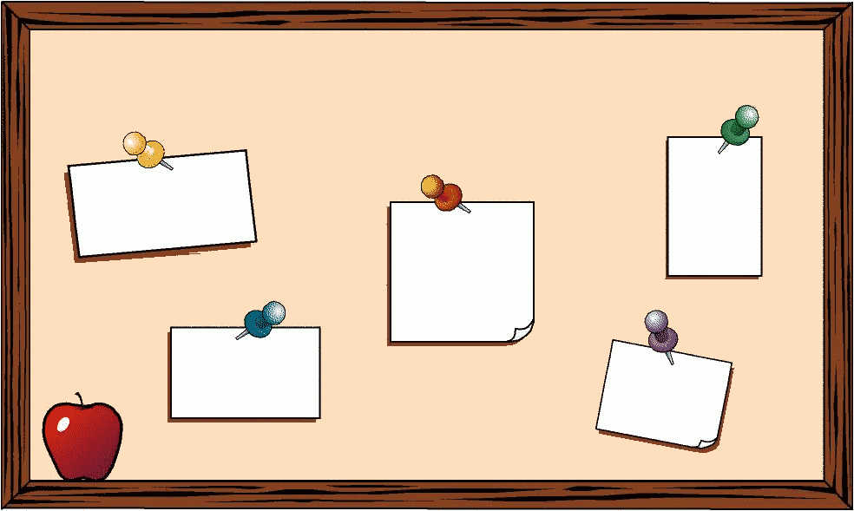
General Info
Toys will not be allowed at school. If transporting items to daycare, items will be expected to stay in the bookbag.
Birthday invitations are fine to send to school. However, students will not be passing them out. The teacher will place them in agendas.
There will be a hot lunch program this year—more details to follow.

